Slide 1

DXC Services for O365
BULPHARMA
Your choice Today for healthier Tomorrow
Notes:
Good morning, Bulpharma colleagues and welcome to our presentation of DXC services for Office 365.
1

Slide 2

Why DXC for Office 365
DXC Proprietary and Confidential
2
DXC Proprietary and Confidential
Notes:
I would like to start with the reason why you should choose us for your Office 365 transformation.

Slide 3

What makes us different
Differentiators
DXC acts as single point of accountability for service operations
DXC and Microsoft teams are collocated and tightly integrated, with unprecedented access to MS resources
Unique case exchange between DXC and Microsoft allows for rapid incident handling
DXC and Microsoft work on incidents together, providing clients with rapid communications and greater visibility to resolution
Proven transformation methodology
Guidance for main workloads and the supporting ecosystem, including authentication, network, devices, applications
Integration with Microsoft FastTrack Center
Leverage our vast experience to accelerate deployment
Comprehensive support — from Office 365 to legacy on-premise environments
Integrated delivery model across cloud and on-premise workloads
Empower your users with self-service training
25 years of experience managing complex environments
More choice over the location of applications/data to support local regulations and data privacy requirements
Expanded data location and support options
Experienced data center management and support
Notes:
What makes us different is that DXC acts as a single point of contact for your smooth service operations and rapid incident resolution. We have a proven transformation methodology and integration with Microsoft FastTrack Center. We offer comprehensive support from Office 365 to legacy on-premise environments and choice over data locations to meet regulation and privacy requirements.

Slide 4
Value you can expect
1
2
3
Leverage DXC’s significant experience in moving 2M user workloads to Office 365 to rapidly identify and overcome challenges in moving email and collaboration workloads
Accelerate time-to-value of your Office 365 investment with Adoption Accelerators
Benefit from a 30-year partnership between DXC and Microsoft and a tightly integrated delivery team that provides rapid incident response and resolution time to reduce business disruption
Notes:
Value that you can expect- Accelerated Transformation, due to the significant DXC experience of moving big user workloads and the 30 year partnership between DXC and Microsoft

Slide 5
DXC provides workplace computing and messaging environment to a large pharmaceutical company
Large
Pharmaceutical Company
"Awesome work everyone!! The results that you have collectively produced are simply amazing! You completed the business migrations in a 3 month period, with no slippage in schedule.” - Director, Collaboration Services
“Congratulations and thank you for what you have poured into this program over the months leading up to and through the migration.” - Sr. Director, IT, Global Infrastructure
CHALLENGE
Significantly reduce IT operating cost
Implement messaging solution that improves productivity, compliance, and security while minimizing disruption to the user community
Increase agility in responding to changing business needs through flexible cloud base environment
SOLUTION
DXC Technology managed the process of migrating the clients users from existing on premise environment to Office 365 Exchange Online. Solution included:
Established migration environment and benchmarked migration through put.
Integration with existing client systems and solutions
“Migration factory” to run migrations and report results
Project management oversight
Migration to state of the art Perimeter Messaging solution
Integration with existing Lync/Enterprise Voice Implementation
Wrapper Service to leverage relationship with Microsoft to provide support of new Office 365 environment
Cost reduction
66,338 mailboxes migrated
RESULTS
Migrated 66,338 mailboxes from Microsoft Exchange to Office 365 Exchange Online and more than 37 TB of data with minimal impact
Standardized processes and innovative services for employees
Reduced cost
Increase mailbox size
Notes:
I want to present to you our recent transformation of a large pharmaceutical company. We have not only managed to migrate 66 000 mailboxes to Office 365, but we have also standardized their processes and innovated the services for their employees, which led to improved customer environment and cost reductions.

Slide 6
BULPHARMA
O365 Exchange Online
Your choice Today for healthier Tomorrow
Current Mode of Operation
Future Mode of Operation
Benefits/Key Features
Timeline, Roadmap and Next Steps
DXC Proprietary and Confidential
6
DXC Proprietary and Confidential
Notes:
In todays presentation we would like to address the pains of your current Exchange environment and transform your environment and user experience with our Office 365 Exchange online services..

Slide 7
Current Mode of Operation On-premise Exchange Platform
Migrate
On-premise to O365 EXCHANGE ONLINE
CHALLENGE
15,000 devices with Windows 7 OS, spread across 12 NCE countries and 7 languages
There are 15,000 On-premise Messaging mailboxes and 15,000 Microsoft Lync Users
Both Office 2010 and Office 2013 are deployed in the standard image
Group data hosted mainly on FPAD servers and NAS devices with two SharePoint Farms 2007 & 2010,
80 Internet Facing sites, 1000 Team Sites and 2 million files
SOLUTION
All end users are deployed on Microsoft Office 365.
Personal Data is hosted on OneDrive for Business.
Group data on SharePoint Online Team sites.
Legacy Messaging Infrastructure
Lack of Innovation and Agility
High Costs
RESULTS
Improved End-user experience and service quality
Improved Cost Efficiencies
Decreased security expenditures while sustaining good security and compliance level
Improved Agility and innovation, using the latest technologies.
Consumption-based model and scalability to support business demand
Notes:
We can help you transform your current on-premise Exchange environment and bring you up-to speed with the innovation engine, enhance your users’ experience and gain cost efficiencies.

Slide 8
Future Mode of Operation Migrate to O365 Exchange Online Platform
Office 365
EXCHANGE ONLINE
Enterprise E3 Plan
USER EXPERIENCE
Team workspaces
Self-service
Actionable insights
Enable mobility
REDUCE COST
Lower Helpdesk Volume
Lower Datacenter Costs
Centralized management
Reduced IT Workload
Scalable Subscription Based Model
Improve User Experience
Reduce Cost
Take Advantage of O365 Security
TAKE ADVANTAGE OF O365 SECURITY
Defense-in-depth Approach
Physical security
Logical security
Data Security
Enterprise-grade User Control
Office 365 Message Encryption
Data Loss prevention
S/MIME
Azure Rights Management
Admin Control
Multi-factor Authentication
Audit-logging
Data Loss Prevention
EOP
Notes:
Based on our detailed business analysis of your current situation, we would like to propose our solution for Office 365 Exchange Online services with Microsoft Enterprise E3 plan. Team workspaces and mobility will empower user productivity. The self service will lead to improved customer satisfaction and lower helpdesk volume. The centralized management and reduced datacenter costs will lead to lower IT work load. The scalable subscription-based model will lead to further cost structure improvement. While at the same time you will take advantage of Office 365 security by defense-in-dept approach, enterprise-grade user and admin control.

Slide 9
O365 Exchange Online Implementation Timeline
May
June
July
Week 1
Week 2
Week 3
Week 4
Week 1
Week 2
Week 3
Week 4
Week 1
Week 2
Week 3
Week 4
April 23rd
Sprint 1
Time (h)
Sprint 2
Time (h)
Sprint 3
Time (h)
Sprint week 1
40
Sprint week 1
40
Sprint week 1
40
Sprint week 2
40
Sprint week 2
40
Sprint week 2
40
Sprint week 3
40
Sprint week 3
40
Sprint week3
40
Sprint week 4
40
Sprint week 4
40
Sprint week 4
40
Sprint review
3
Sprint review
3
Sprint review
3
Tenant Setup
Hybrid Setup
Migration
Notes:
This is how our proposed migration will take place, making use of Agile practices, and within 3 months we will set-up your tenant, help you transform to a hybrid set-up and finally migrate you to your new Office 365 environment.

Slide 10







Workplace and Mobility Roadmap
Mobile services
Mobile apps
Mobile devices
Mobile platform
Mobile network
Mobile security
Consulting, development, testing & mobile management
Pharma reference apps for payers and providers
Pharma
devices
Secure enterprise-grade mobile platforms
Unified wired and wireless networking solutions
Security solutions across every layer of the mobile environment
End-to-end services & solutions for pharma organizations
Proactive, personalized care.
Agile, interoperable
Modern workplace
2019
2022
Pharma-grade cloud and mobility technology
Familiar, best-in-class productivity on any device
Automated workflows between apps and services
Built custom
business apps
Pharma-grade devices with built-in security and access management
Firstline Workforce App in Office 365
User identity, mobile device management, data protection
Enterprise Mobility + Security
Notes:
For your workplace and mobility roadmap towards an agile and interoperable modern workplace, we can offer you mobile services, mobile apps, devices, platform, network and security, accompanied with Microsoft products, such as Staffhub, Flow, PowerApps, etc.

Slide 11
Next Steps
DXC Proprietary and Confidential
11
DXC Proprietary and Confidential
Notes:
What are the next steps?

Slide 12

Get started: Schedule your Advisory services for Flow and PowerApps for Office 365
Identify business value
Examine current state
Balance the demand between tactical and strategic information initiatives
Set priorities to discover and explore the possibilities
Next: Follow with the DXC Detailed Deployment Planning Workshop for Office 365.
Work up your plan to move your business to Office 365 Faster, Cheaper and Smarter!
April 22, 2019
April 22, 2019
12
Notes:
We encourage you to schedule your advisory services for Flow and PowerApps, which will help us create business value for you, examine your current state in details, prioritize your tactical and strategic initiatives and explore the opportunities. Then we can follow with a detailed planning workshop to move your business to Office 365 faster, cheaper and smarter.

Slide 13

Thank You
DXC Proprietary and Confidential
13
DXC Proprietary and Confidential
Notes:
I would like to thank you for your time and attention and now let’s move to the second part of our presentation, where our senior Digital Developer Elena will demonstrate a live preview of the solution under development for Bulpharma.

Slide 14
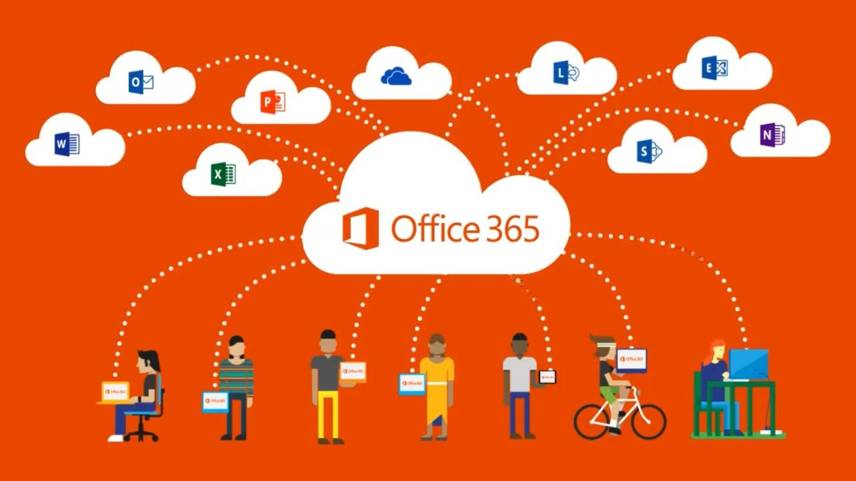
DEMO
Notes:
Elena, over to you.

